Slide 1
KISANCONNECT
Theme based project- Review I

Slide 2
CONTENTS
Problem Statement
Introduction.
Objectives.
Technologies.

Slide 3
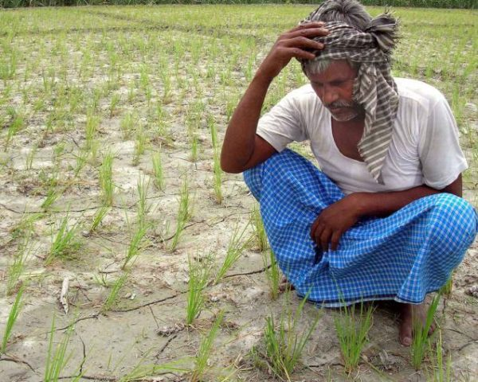
PROBLEM STATEMENT
Many of the times, even after having a good crop, farmers face difficulties due to the low price they get in the market.
This may be due to lack of communication between farmer community.

Slide 4
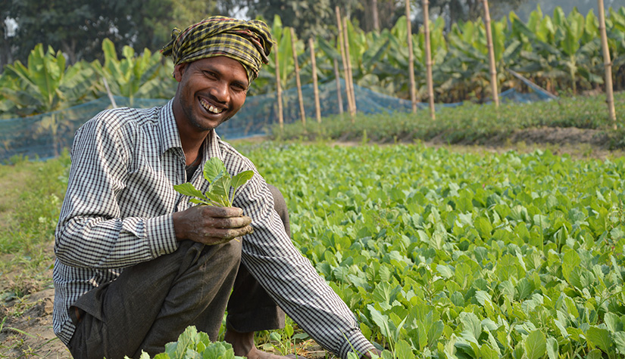
Our Website provides farmer, specific information which helps him in decision making.

Slide 5
Motivation
Often the price fluctuates for a crop that the farmer cultivates.
Due to price – supply chain .
Because of this, backbone of our country is loosing hope on the Agriculture.
We try to fill the essential knowledge gap that the farmer is lacking.

Slide 6
Objectives
Our Web Application will provide the important information on crop cultivating.
How much area particular crop is cultivating currently.
We will predict the price for a crop based on past years data.
We will try to improvise taking climate and other factors into considerations.
User is mostly uneducated so try to present data visually(graphical) using graphs, tables.

Slide 7
Technologies
Django framework for front end and back end.
Bootstrap to design front end templates.
Postgre Sql for the databases.
Rest API to get the data in Jason format.
Crop API for the data sets.
Pandas for data graphical representation.

Slide 8
THANK YOU!

